Slide 1
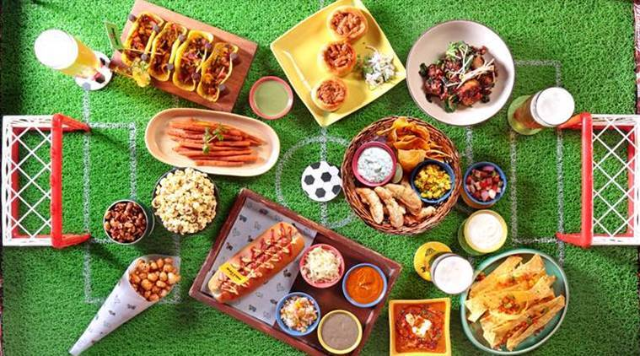
FIFA World Cup and Food Business
Group 3:
Aarya Paudyal
Atithi Prasai
Divi Joshi
Siddharth Lakhani
Weiheng Ze
Yash Luharuka
Zhengkai Zhou

Slide 2
Table of contents
Introduction
Details and important events in Soccer
Business problem
Assumptions
Data wrangling
Tableau dashboard
Managerial implications
Final pitch

Slide 3
Introduction
Football/soccer is a global phenomenon with millions of fans worldwide.
It is one of the most popular sports with a rich history of memorable moments and important events.
FIFA World Cup international tournament is held every four years.
Widely considered the most-watched sports event with record breaking viewership numbers.
Qatar hosted the 2022 FIFA World Cup, the first time in the Middle East.
The 2026 tournament will be jointly hosted by Mexico, Canada, and the United States, with Mexico as the first three-time host.
2022 Qatar World Cup is the first World Cup soccer tournament to be held in the northern hemisphere in winter.

Slide 4
Events
Halftime
Offside
Break
Red Card
1
0
Goal
Yellow Card
Penalty
Corner Kick

Slide 5
Schedule
64 Matches
Semifinals :2
Group Stage : 48
Winner : 1
1/8 Finals : 8
3rd and 4th Places : 1
Quarter Finals : 4

Slide 6
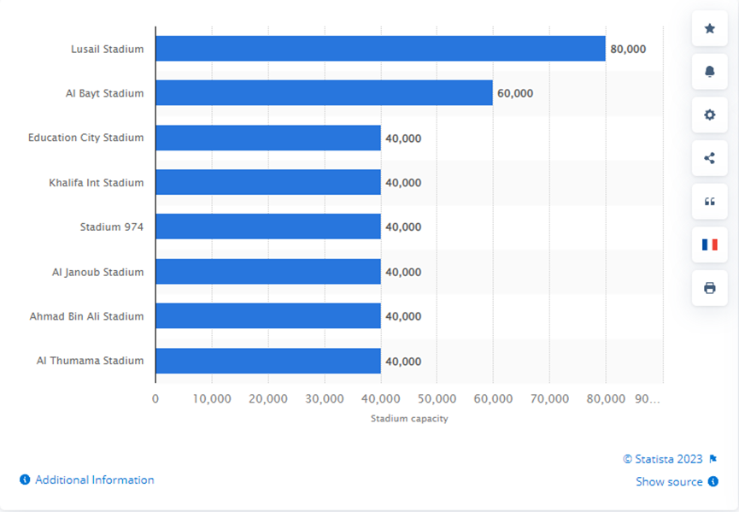
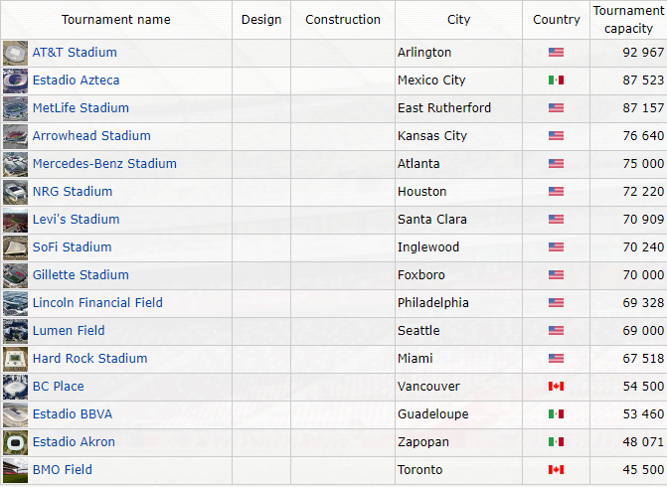
Stadium Capacity
Stadium Capacity in Qatar Stadiums
(FIFA 2022 World Cup)
Stadium capacity in US, Canada, Mexico stadiums
(for 2026 world cup)

Slide 7
FIFA World Cup 2022 Menu
Traditional Arabic
International Favorites
Snacks
Beverages
Fatayer with Spinach/Meat
Fatayer with Cheese
Lugaimat
Hot Dogs Cheese Rolls
Veggie Rolls Potato Chips Coldcuts
Mixed Nuts
Popcorns
Soft Drinks
Water
Non Alcoholic Beverages

Slide 8
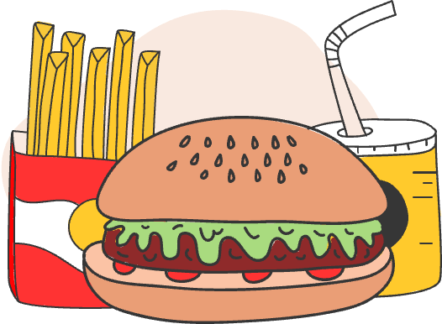




Sample Menu of US Stadiums
SANDWICHES
SALAD
CANDY
Burgers
Hotdogs
Side
Composed
Gummies
Chocolate Bars
DESSERTS
SIDES
BEVERAGES
Ice Cream Churros Donuts
Nachos/Tacos Onion Rings
Soda Juice Beer

Slide 9
Concession Wait Times
Longer wait times may discourage fans from making purchases
Reducing wait times leads to improved revenues
Mobile ordering and payment, self-service kiosk to decrease wait times
Utilize Data Analytics to Optimize Inventory Management

Slide 10
Business Problem
Lack of data-driven insights on food preferences of fans during the FIFA World Cup, leading to missed opportunities to increase revenue.
Development of visual dashboards can help vendors monitor and improve availability and accessibility of food and beverages for fans.
Combining events in the game with overall sales data can provide insights on fans' needs and preferences, leading to data-driven decisions to enhance overall fan experience.
Utilizing predictive analytics for improved inventory management and delivery times can be a potential solution.
Importance of improving food options and delivery experience at FIFA World Cup events for enhanced fan experience, satisfaction, engagement, and revenue.
Example from the 2014 FIFA World Cup in Brazil highlights the negative impact of limited and poorly managed food options on fan experience, emphasizing the need for data-driven solutions in the culinary industry.
Notes:
Lack of data-driven insights on food preferences of individual fans during the FIFA World Cup, leading to missed opportunities to enhance fan experience and increase revenue.
Development of visual dashboards can help vendors monitor and improve availability and accessibility of food and beverages for fans.
Tracking metrics like wait times, menu items, and sales data can provide insights on fans' needs and preferences, leading to data-driven decisions to enhance overall fan experience.
Utilizing predictive analytics and artificial intelligence for improved inventory management and delivery times can be a potential culinary solution.
Importance of improving food options and delivery experience at FIFA World Cup events for enhanced fan experience, satisfaction, engagement, and revenue.
Example from the 2014 FIFA World Cup in Brazil highlights the negative impact of limited and poorly managed food options on fan experience, emphasizing the need for data-driven solutions in the culinary industry.

Slide 11
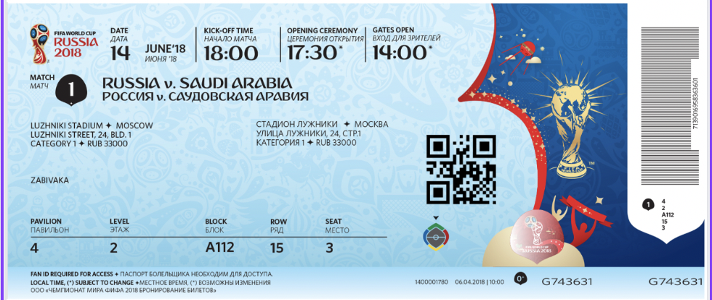
Assumptions
The FIFA world cup match is between Germany and Brazil.
It will begin at 9:00 pm and end at 11:38 pm.
Generated data for 400 audience here is equivalent to roughly 40,000 spectators that had come to watch the match.
Information about customer's age, their seat location and the team they are supporting are collected through their tickets.
Customers have the option of ordering food either through the food ordering app or directly at the stall.
Customers enter their dietary preference while ordering their food.

Slide 12
Data Generation
Match duration - 9:30pm to 11:35 pm
400 respondents are our sample size
The venue is divided into four zones: East, West, North and South.
Respondents have dietary preferences of Vegan, Vegetarian, Non-Veg and Gluten-Free.
36 items are offered in the menu. Some of the popular food items like Nachos, French Fries, Pizza, Beer, Salads and so on will be purchased.
Events such as goal, corner kick, yellow card, red card and penalty will occur.
Order time will be generated with a maximum deviation of 3 minutes from the event time

Slide 13
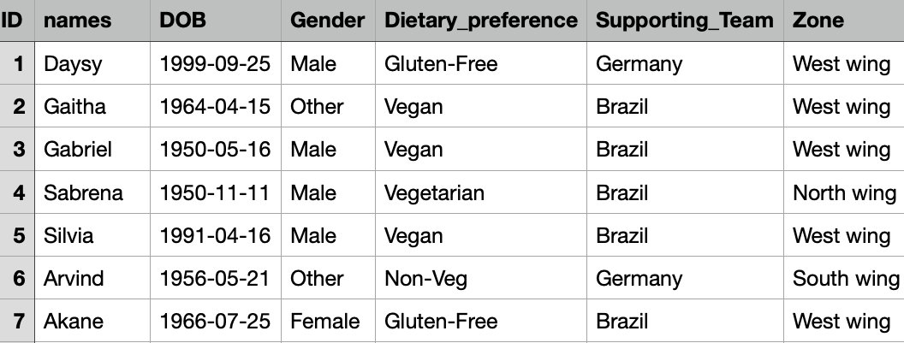
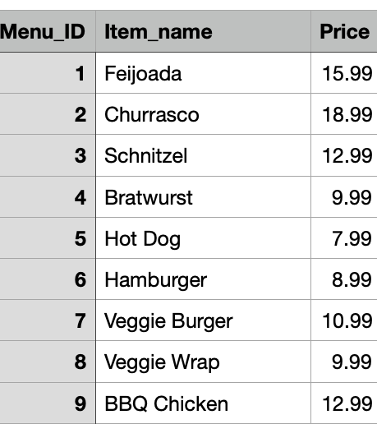
Audience
Menu

Slide 14
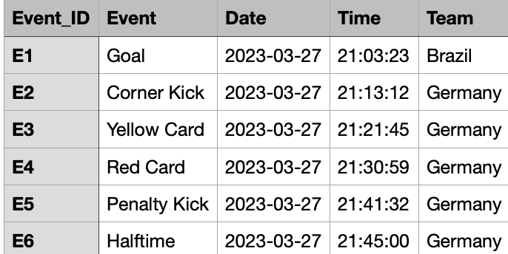
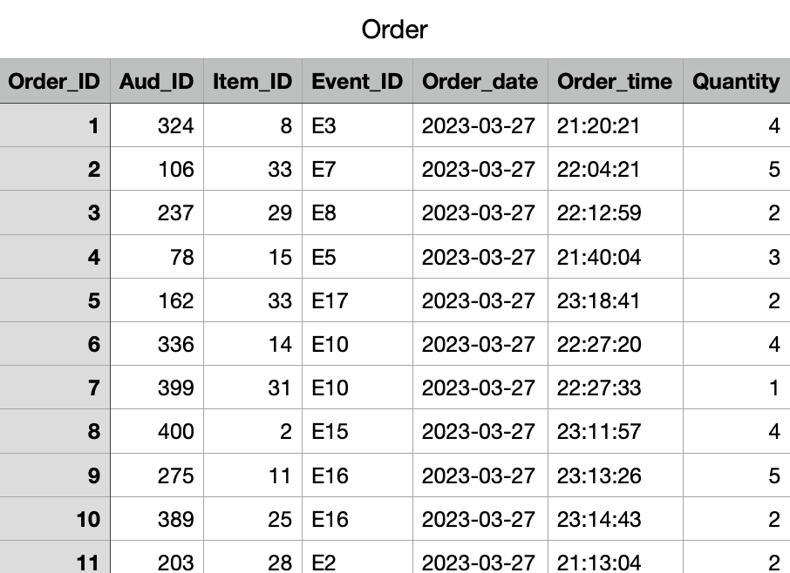
Event
Order

Slide 15
Data Cleaning and Transformation
Checked the missing values and the data frame
Changed the data type of order date, DOB and events date to date type from character.
United Order_date column with Order_time column.

Slide 16
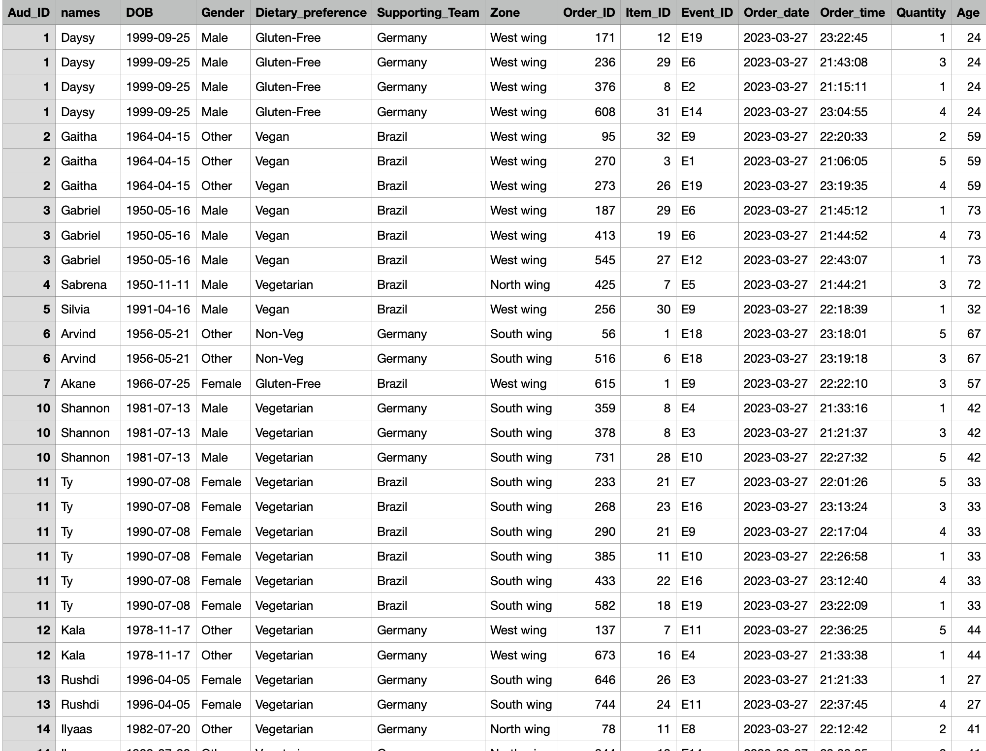
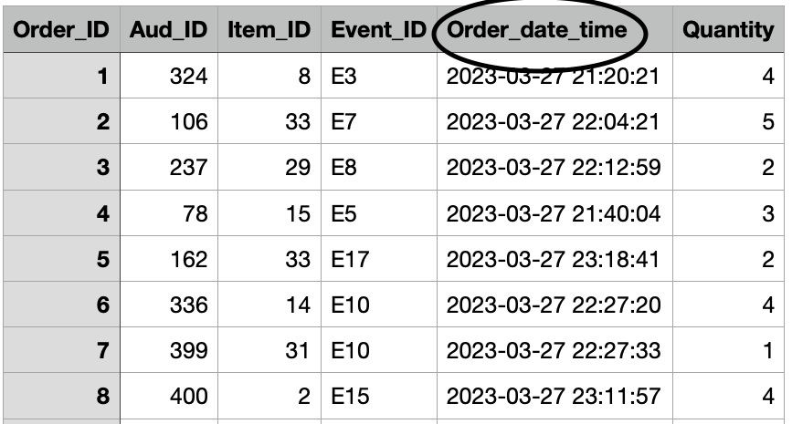
Data Wrangling
United Order_date column with Order_time column using – unite function
Joined audience and order table- innerjoin function
Created and calculated new Column “Age” using DOB and Order date- age_calc function.
Notes:
Following R functions have been used:
randomNames
Lubridate
Sample
As.Date
Data.frame

Slide 17
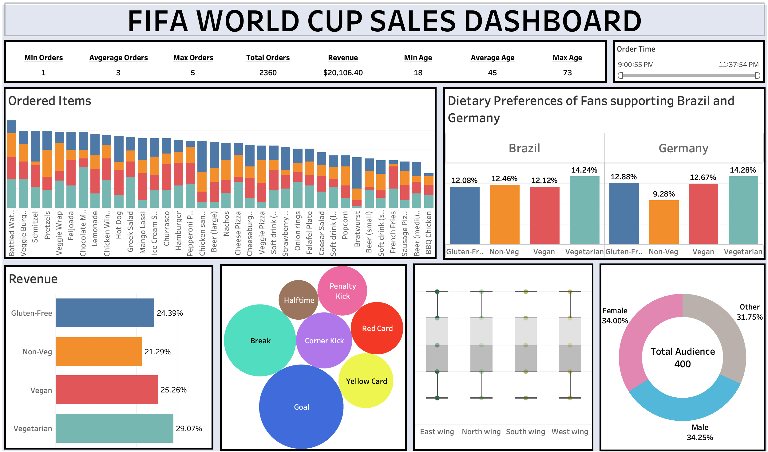
Tableau Dashboard
https://public.tableau.com/app/profile/divi.joshi/viz/Revised_16819069640000/Dashboard?publish=yes
Notes:
https://public.tableau.com/app/profile/divi.joshi/viz/Revised_16819069640000/Dashboard?publish=yes

Slide 18
Managerial Implications
Enhanced Fan Experience
Increased Sales and Revenue
Operational Efficiency
Cost Reduction
Data-Driven Insights
Technology Management
Partnership Management
Better understanding / prediction on the expected orders, hence efficient inventory management
Vendor can decide to throw offers at different zones of the stadium based on the analysis and dashboard data

Slide 19
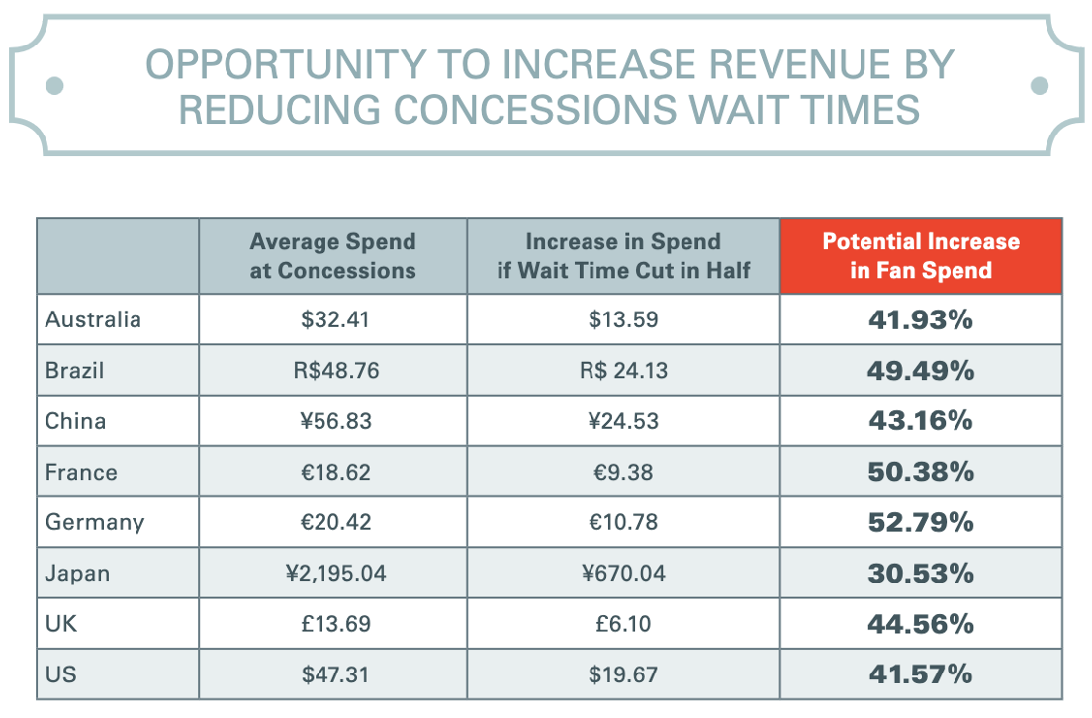
Final Pitch
If an investor/Stadium owner is investing in this App/ dashboard product he/she can expect an estimated profitability increase of at least 30%.
The product development will be on 2 ends – One is the food ordering app that the customers will use and the dashboard that the stadium restaurant manager will monitor.
Reduction in concessions wait time by almost 40% hence increased customer spend.
*As per a report titled "Stadium of the Future" by Oracle, sports venues can increase revenue by reducing wait times at concession stands.

Slide 20
Thank you

